Slide 1
Seattle Preschool Program Technical Assistance Pool
On- Call Consultant Services RFQ
Pre-Submittal Conference
May 30, 2019

Slide 2
Introductions
Finance & Administrative Services (FAS)
  Capital Development & Construction Management Division (CDCM)
  Represented by:
  Larry Ahern- Senior Project Manager
Department of Education and Early Learning (DEEL)
    Represented by:
    Jenny Choi- Senior Policy & Planning Specialist

Slide 3
Seattle Preschool Program (SPP)
Architectural/Project Management Consultant Services
SPP Overview
RFQ Purpose
Past Projects
Consultant Contract Requirements
RFQ Selection Timeline
RFQ Selection Process

Slide 4
SPP Overview
SPP offers competitive rates for providers, high-quality professional development, and access to organizational capacity building funds (staff tuition support, facilities funding, etc.)
DEEL has $7.56 million to support facilities expansion, renovation, or improvement
78 classrooms and 2 Family Child Care (FCC) hubs currently are enrolled in the program
19 centers are enrolled in the Pathways Program – indicating they intend to apply to participate in SPP within 2 years

Slide 5
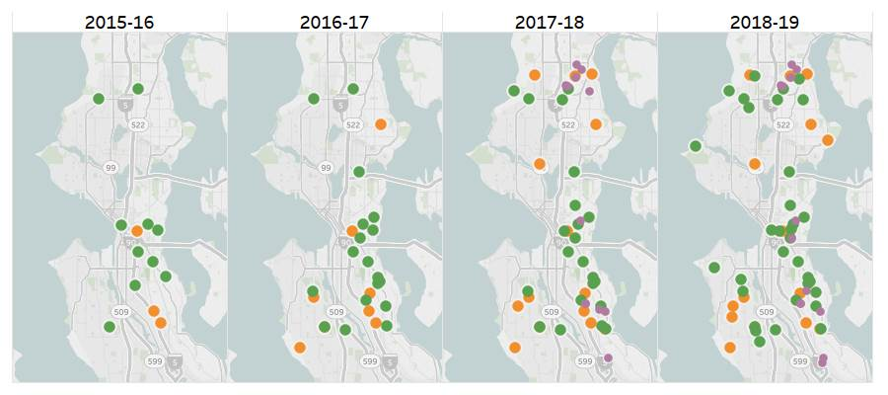
SPP Expansion from 2015 to 2018
n SPS Sites n CBO Sites n FCC Sites

Slide 6
RFQ Purpose
Develop a pool of architectural and project management consultants to support SPP providers in developing capital expansion projects
Preschool providers need capital expertise and support to get their projects off the ground
A companion development program by DEEL will provide capital funding to implement projects proposed by SPP providers

Slide 7

Past Projects
Refugee Women’s Alliance
First Place
East African Development Center
Sound Child Care Solutions
YMCA
Launch
… and more!

Slide 8
Consultant Contract Requirements
Consultant Questionnaire:
  Must be completed and returned in your submittal
Equal Benefits Compliance Declaration
  Firms must provide same or equal benefits to employees and partners whether married or in domestic partnerships
WMBE Requirements
  No specific requirements due to contract size but the City strongly encourages WMBE participation in support of the City’s value of diversity

Slide 9
RFQ Selection Timeline
Date | Item
2:00 PM, June 6th | Deadline for Questions
2:00 PM, June 13th | RFQ Submittals Due
Week of June 17th* | Submittal Evaluation
Week of July 1st | Consultant Selection
* If interviews are required, they will be the week of June 24th
Notes:
(Dwane)

Slide 10
RFQ Selection Process
Selection committee
  CDCM representatives
  DEEL representatives
Submittals will be pre-screened and evaluated based on the selection criteria found in the RFQ
  http:// www.ebidexchange.com/seattle

Slide 11
Questions?
Larry Ahern
  larry.ahern@seattle.gov
  206.733.9135
RFQ Link
  http:// www.ebidexchange.com/seattle

