Slide 1
FIRE STATION 31 REPLACEMENT
RFQ PRE-SUBMITTAL CONFERENCE

Slide 2
Introductions
Department of Finance and Administrative Services (FAS)
Capital Development (CD)
Mark Miller, RFQ Manager
Stacy Carter, Contract Administrator
David Nguyen, Administrative Assistant
Seattle Fire Department (SFD)
Captain Dan Murray
Notes:
FAS building owner / SFD building tenant

Slide 3
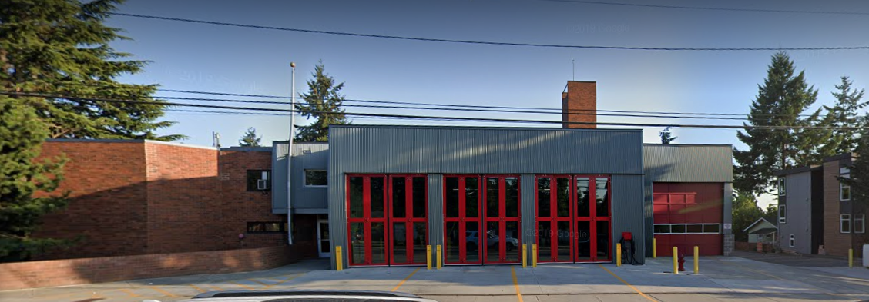
Project Background
2003 - Existing 1973 fire station renovated during Fire Facilities and Emergency Response Program
2003 – 2019 - Other improvements
Oct. 2019 - Mayor, SFD & FAS determined station no longer met operational needs
May 2020 – New site acquired
Notes:
1310 N Northgate Way
Due diligence – response time analysis, Test Fit, survey, PHII assessment,
Note Interim Station across the street

Slide 4
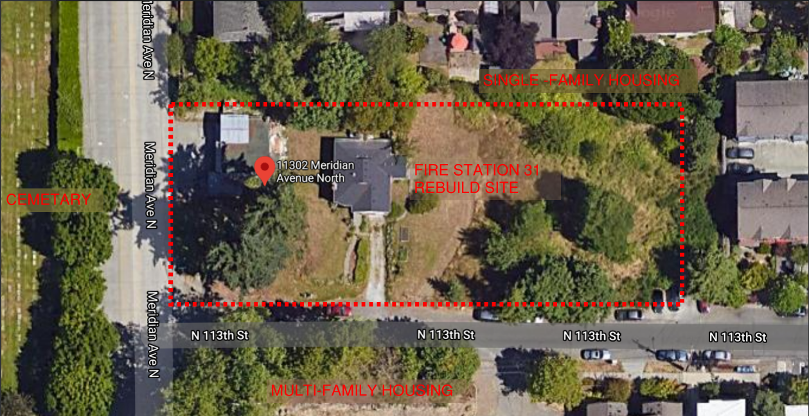
New Site 11302 Meridian Avenue N
Notes:
# of blocks north of existing station

Slide 5
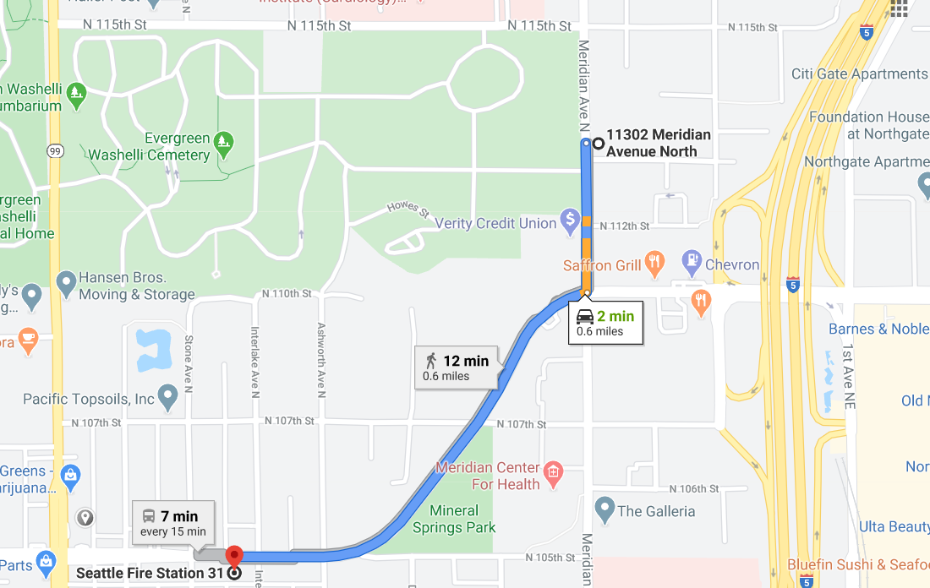
New Site 11302 Meridian Avenue N
Notes:
# of blocks north of existing station

Slide 6
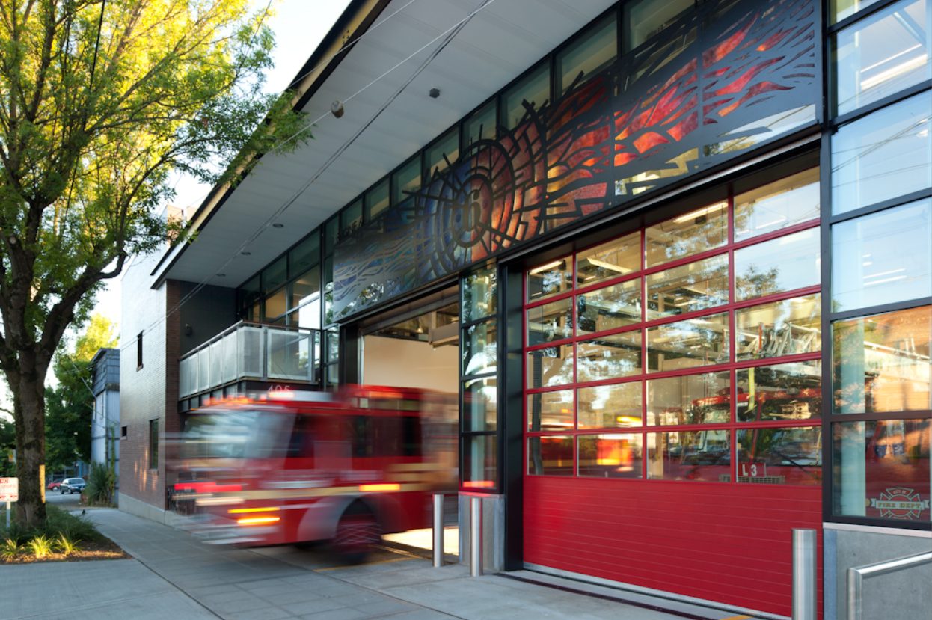
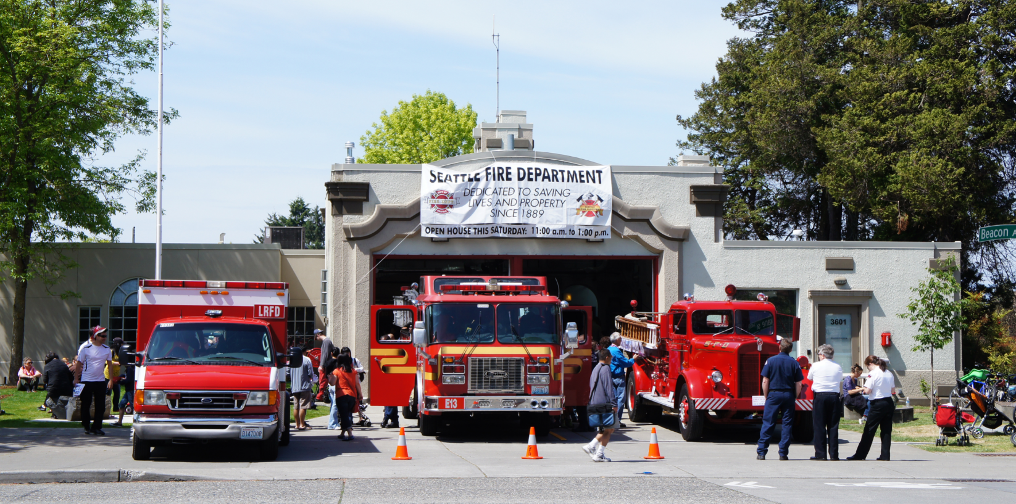
Project Details
New Station on New Site
Building size: Approx. 21,000 SF
12 Active Duty Personnel
Minimum of 4 Apparatus
Public Outreach through Open Houses
Design Commission Review Required
1% for Art included in this Project
Notes:
Engine 31, Ladder 5, Medic 31 and Aid 31
Site Address: 11302 Meridian Avenue

Slide 7
Project Programming Phase
2007 COS Fire Station Universal Programming Manual – Provided
Further Programming Updates from Levy Program – To be Provided to Selected Team
Program Verification is Required
SFD Operational Changes
COVID-19
Notes:
Engine 31, Ladder 5, Medic 31 and Aid 31
Site Address: 11302 Meridian Avenue

Slide 8
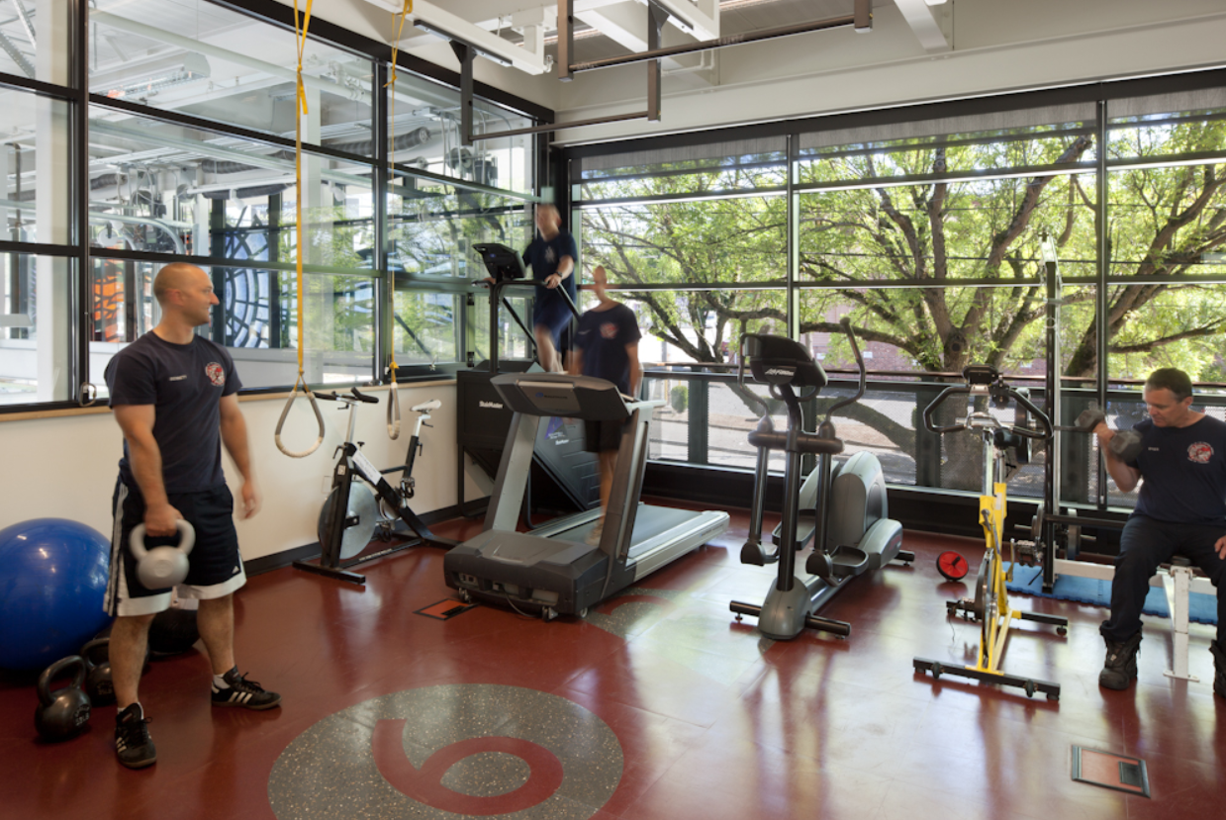
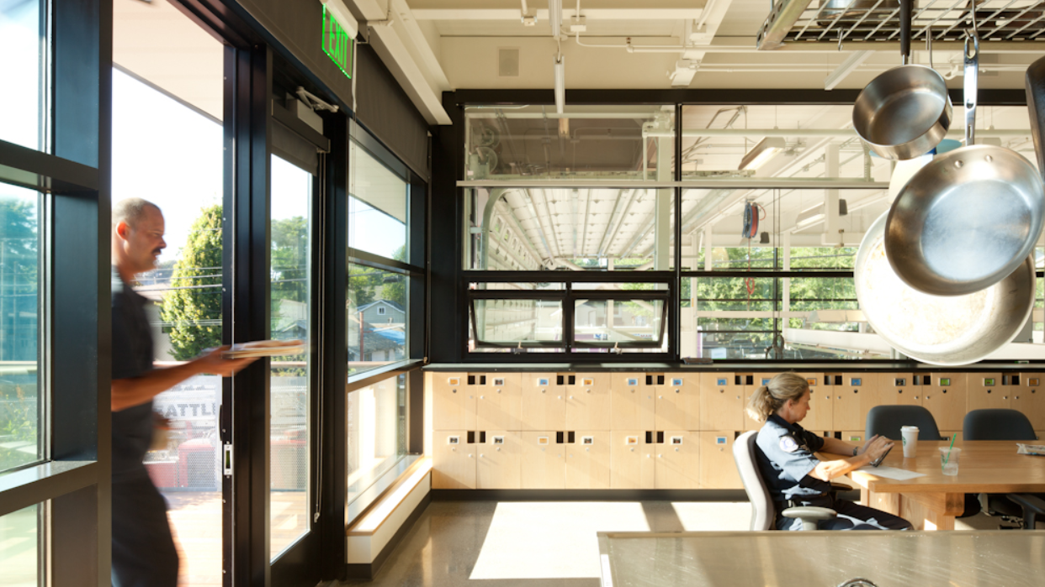
Project Schedule
Design Team Selection – Oct 2020
Contract Negotiations – Oct / Nov 2020
PreDesign / Programming / SD – Nov 2020
City Sets MACC
Design – Q2 2021
Construction – Q1 2023
Completion - Mid-2024
Notes:
Move in Mid-2024

Slide 9
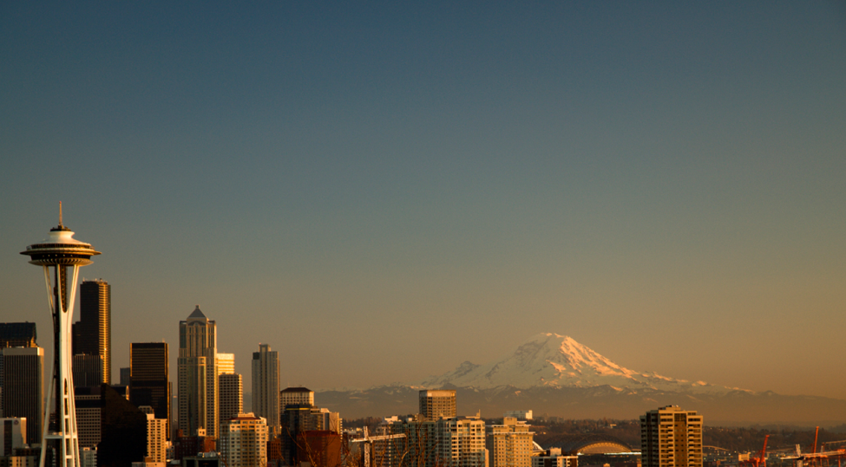
Sustainability
USGBC accredited team member required
Sustainable Buildings and Sites Policy
LEED Gold
15% min. more efficient energy use intensity performance
30% min. more efficient water use performance
90% waste diversion rate for demo, 75% waste diversion rate for non-demo
Bicycle parking and changing/showering facilities
Green New Deal – Requires station to be fossil fuel free

Slide 10
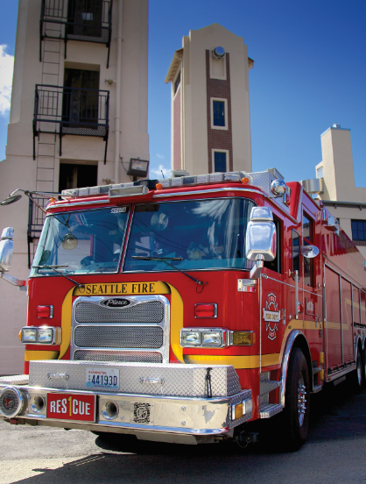
Consultant Contract Requirements
Mandatory Forms
Consultant Contract Questionnaire with Equal Benefits Declaration
Consultant Inclusion Plan – 10% of Submittal Score
Consultant performance evaluation
Contact: Stacy Carter - stacy.carter@seattle.gov

Slide 11
RFQ Selection Timeline
Deadline for questions: August 14 - 5 pm
Electronic Submittals due to the City: September 1 - 2 pm
Notifications of shortlist: September 8 – 18
Interviews (optional): Week of September 28
Consultant selection: Week of October 5

Slide 12
RFQ Selection Process
Selection Team
FAS / CD Representatives
SFD Representatives
Design Commission Representative
https://seattle.procureware.com/login
Note: Do not visit any station sites or contact any members of the Seattle Fire Department. Short-listed firms will be invited to tour the site.

Slide 13
Questions?
Stacy Carter, Contracts Administrator
stacy.carter@seattle.gov
RFQ Addenda Postings:
https://seattle.procureware.com/login

